Slide 1
First Things First

Slide 2


Slide 3

Introduce TypeScript
Install what we need
Module Overview
Set up and run our Angular application
Create an Angular application with the Angular CLI

Slide 4
TypeScript
is the programming language we use
when building Angular applications

Slide 5

JavaScript
The language for the Web
ECMAScript (ES) ES 3/5
ES 2015 (formerly known as ES 6)
Classes
Arrow functions
Newer JavaScript transpiled to older JavaScript

Slide 6
TypeScript
Open-source language
Superset of JavaScript Transpiles to plain JavaScript Strongly typed
Class-based object-orientation

Slide 7

Learning More
TypeScript Playground
https://www.typescriptlang.org/play

Slide 8

Installing What We Need
Editor
- Visual Studio (VS) Code

Slide 9
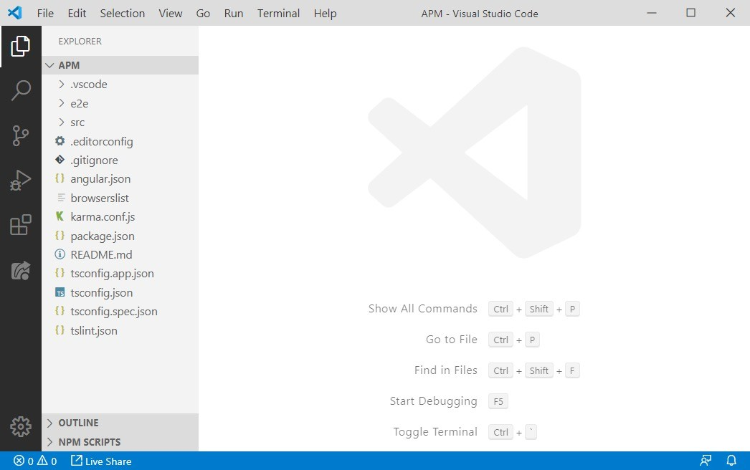
VS Code
Created by Microsoft
Runs in Linux, Windows, and OS X
Has numerous features that support TypeScript
Auto-completion
Intellisense
Syntax checking
Refactorings
It's FREE

Slide 10
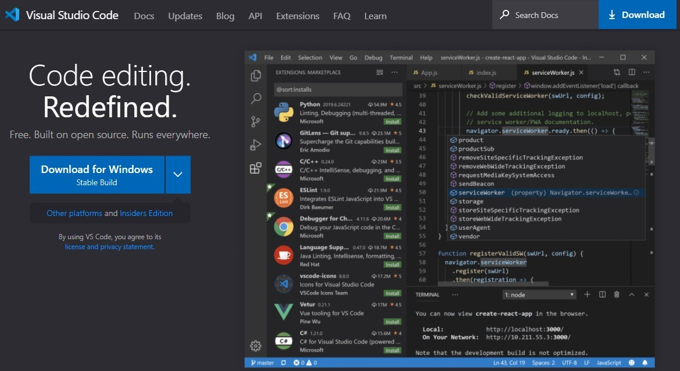
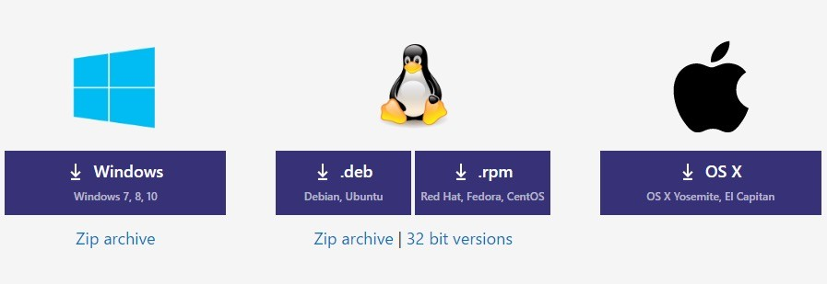
Visual Studio Code
https://code.visualstudio.com/

Slide 11
Learning More
Visual Studio Code Site https://code.visualstudio.com/

Slide 12
Installing What We Need
✓Editor
- VS Code

Slide 13
Installing What We Need
✓Editor
VS Code
npm
Node package manager

Slide 14
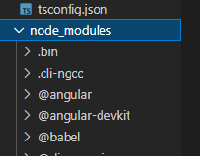

npm
Angular TypeScript Bootstrap etc...
Open-source repository
Command-line utility for interacting with the repository

Slide 15

npm
Installs libraries, packages, and applications
Executes scripts https://nodejs.org/en/download

Slide 16
Check Version of NPM

Slide 17
Installing What We Need
✓Editor
VS Code
✓npm
Node package manager

Slide 18
What Else Do We Need?
Angular
Framework and libraries
Angular CLI
Command line interface for Angular
TypeScript
Programming language
Testing tools, linters, etc.

Slide 19
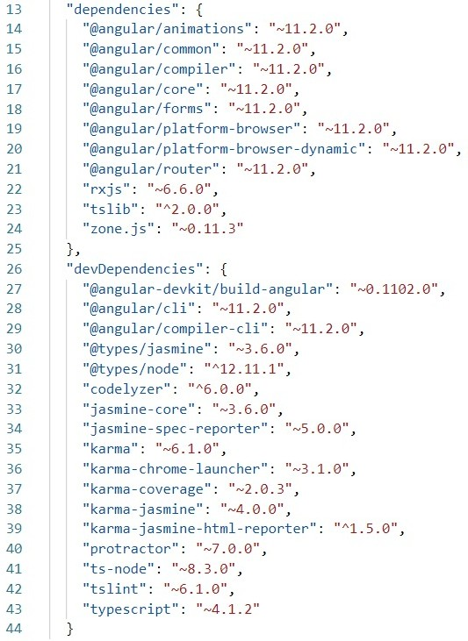
package.json
dependencies
Packages required for development and deployment
devDependencies
Packages only required for development

Slide 20
When Setting Up Existing Angular Code
#1
#2
#3
Navigate down to the project folder
The project folder contains the package.json file
Run: npm install
To install the packages defined in the package.json file
Run: npm start
To start the installed Angular application

Slide 21

Setting up Our Angular Application
Starter files in GitHub Repository

Slide 22
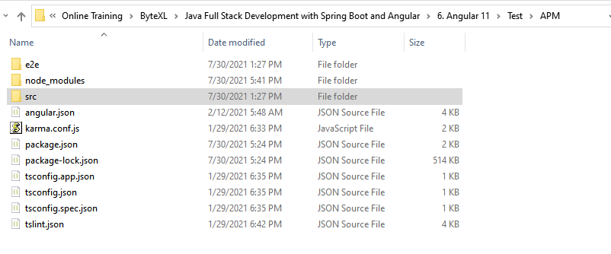

Slide 23
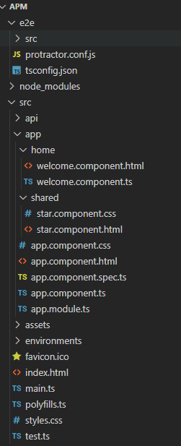

Slide 24
When Setting Up Existing Angular Code
#1
#2
#3
Navigate down to the project folder
The project folder contains the package.json file
Run: npm install
To install the packages defined in the package.json file
Run: npm start
To start the installed Angular application

Slide 25

Demo
Create an Angular app using the Angular CLI

Slide 26
Instal Angular CLI Globally

Slide 27
Introduced TypeScript
Installed what we need
Summary
Editor (VS Code)
npm (node)
Set up and ran our Angular application
Used the Angular CLI to create a new Angular application

Slide 28
Angular CLI
Global Angular CLI
projects/apm
projects/hello-world
projects/cms
Local Angular CLI
Local Angular CLI
Local Angular CLI

Slide 29
Application Architecture
Welcome Component
index.html
App Component
Product List Component
Star Component
Product Detail Component
Product Data Service

Slide 30
Application Architecture
Welcome Component
index.html
App Component
Product List Component
Star Component
Product Detail Component
Product Data Service

Slide 31
Application Architecture
Welcome Component
index.html
App Component
Product List Component
Star Component
Product Detail Component
Product Data Service

Slide 32

Coming up next …
Introduction to Components

